Slide 1

Body Fat Assignment
Stat 628 Module 2
RUI HUANG
CHENYANG JIANG
HanGyu KANG
ENZE WANG

Slide 2
Introduction
Body Fat Percentage = total mass of fat / total body mass.
A precise way to measure body fat is to combine submersion method with Siri equation (Body fat=495/Density-450). But it is difficult.
Our group want to figure out a convenient way to predict body fat.

Slide 3
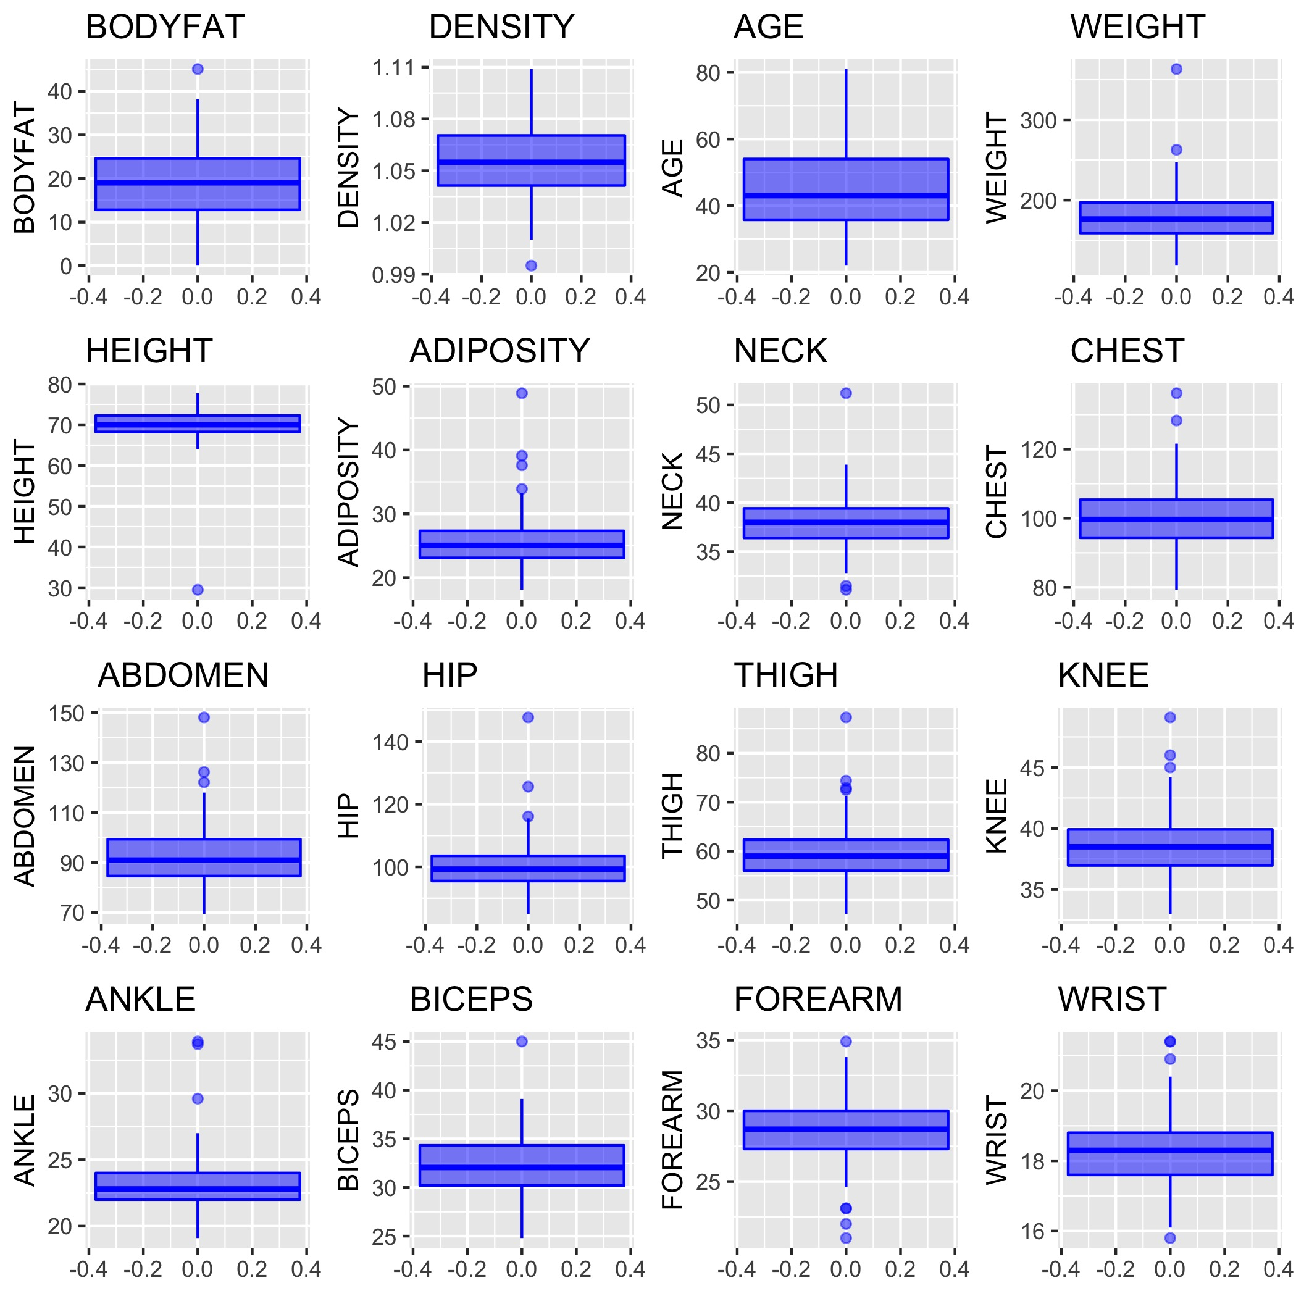
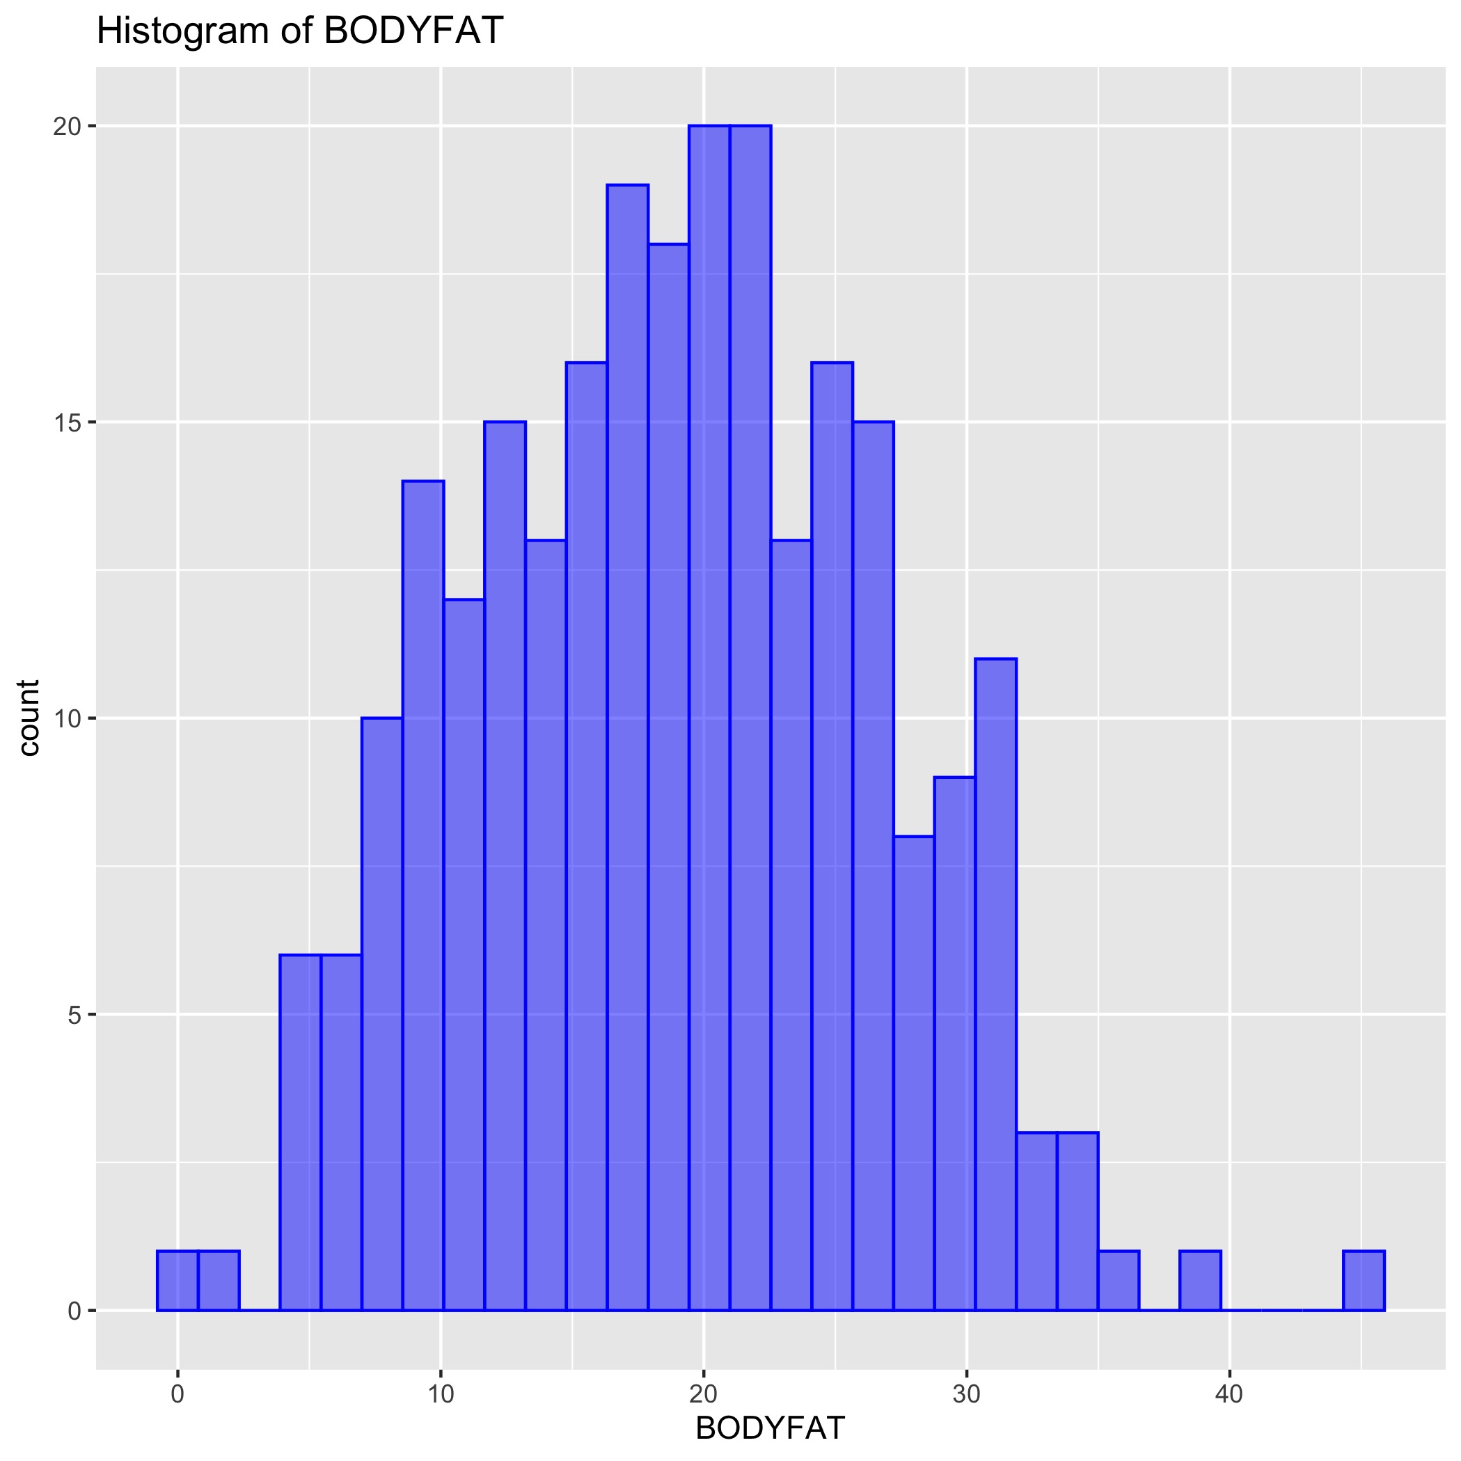
Data Analysis
252 observations and 16 valid variables.
Study data distribution and range.
Find any outliers.
Find any null and abnormal value

Slide 4
Data Clean - Boxplots
Outstanding outliers:
There are only about 250 observation, so we want to fix and keep as many outliers as possible.
IDNO | Reason | Method
182 | BODYFAT is 0, BODYFAT from Siri equation is negative | Remove
216 | Extreme value in BODYFAT | Keep
39 | Outliers from boxplots | Keep, but it will be in influential observation in linear regression
42 | Low HEIGHT | Fix by BMI equation, update HEIGHT by 69 inches
41 | Outliers from boxplots | Keep

Slide 5
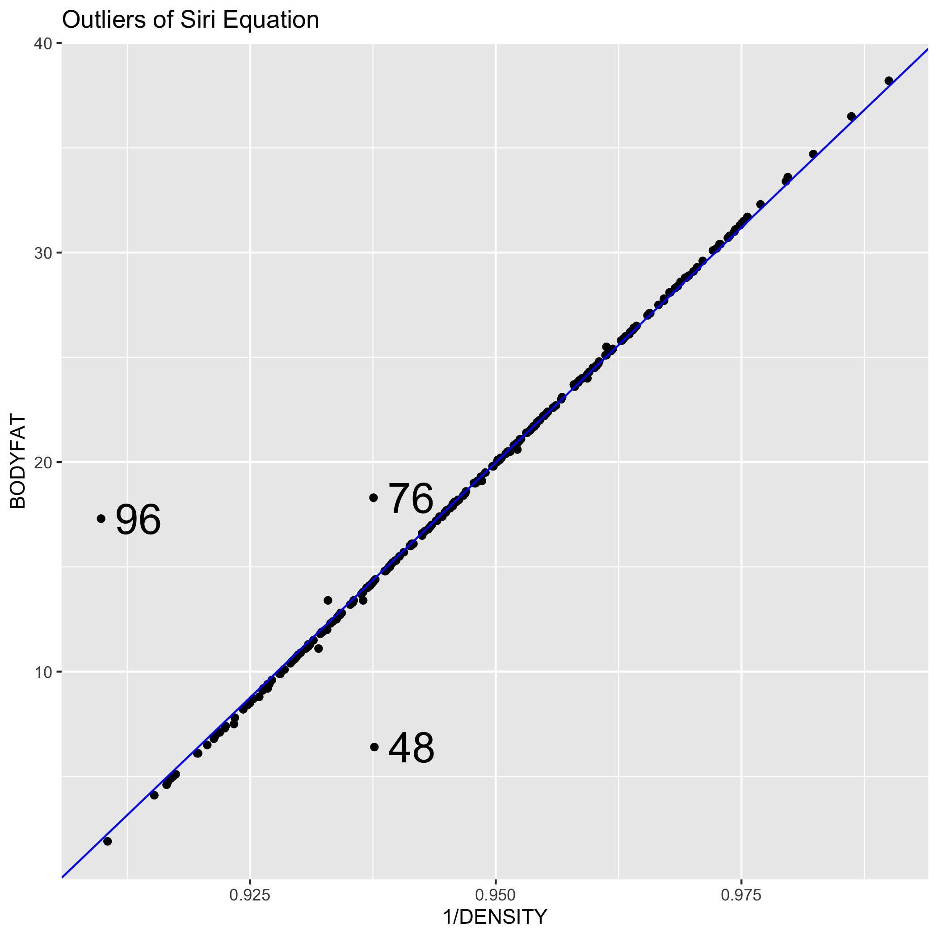
Data Clean – Siri Equation
Connection between BODYFAT and DENSITY in our data is called Siri equation.
Siri equation: BODYFAT=495/DENSITY-450.
Outstanding outliers in regression between BODYFAT and 1/DENSITY.
You can also compare the new BODYFAT from Siri equation with initial one.
IDNO | Initial BODYFAT | New BODYFAT | Method
96 | 17.3 | 0.36 | Keep initial BODYFAT
76 | 18.3 | 14.09 | Update BODYFAT
48 | 6.4 | 14.13 | Update BODYFAT

